Slide 1
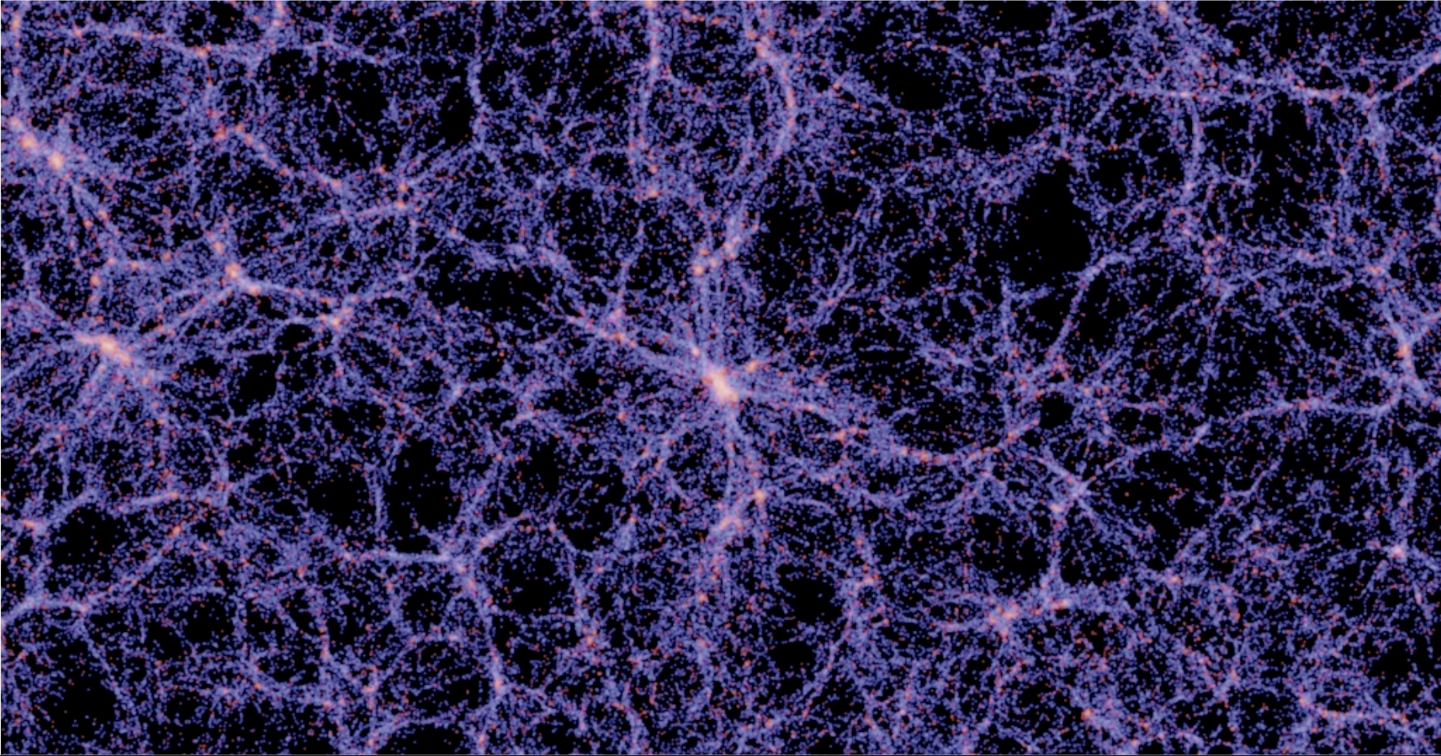

Inferring Cosmological Parameters from
Void Properties
By: The Extremely Extravagant Elephants
Sparsh, Vedang, Joseph, Manny
Physics C170M Final Presentation
14th March, 2024

Slide 2
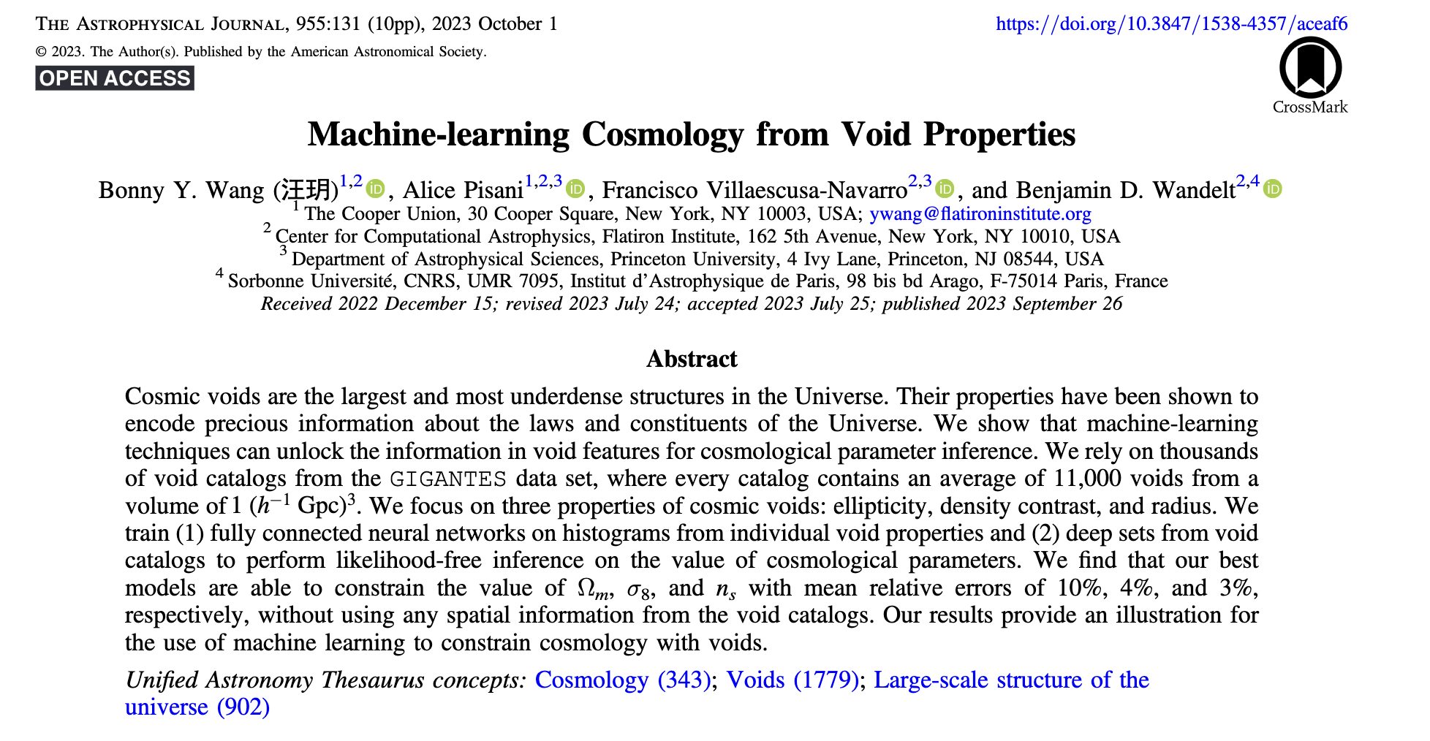

Slide 3
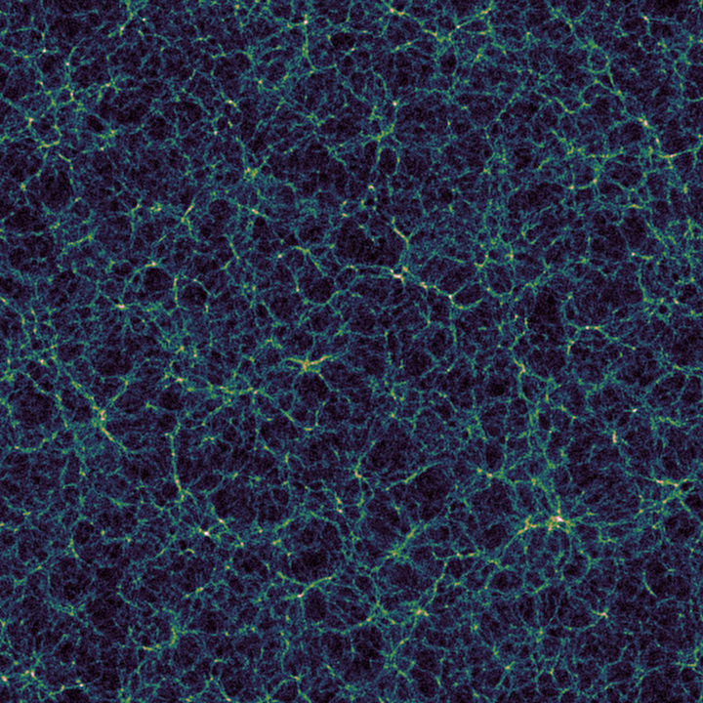
What are Cosmic Voids?
Vast regions of relatively low densities
Image Source: Wikipedia

Slide 4
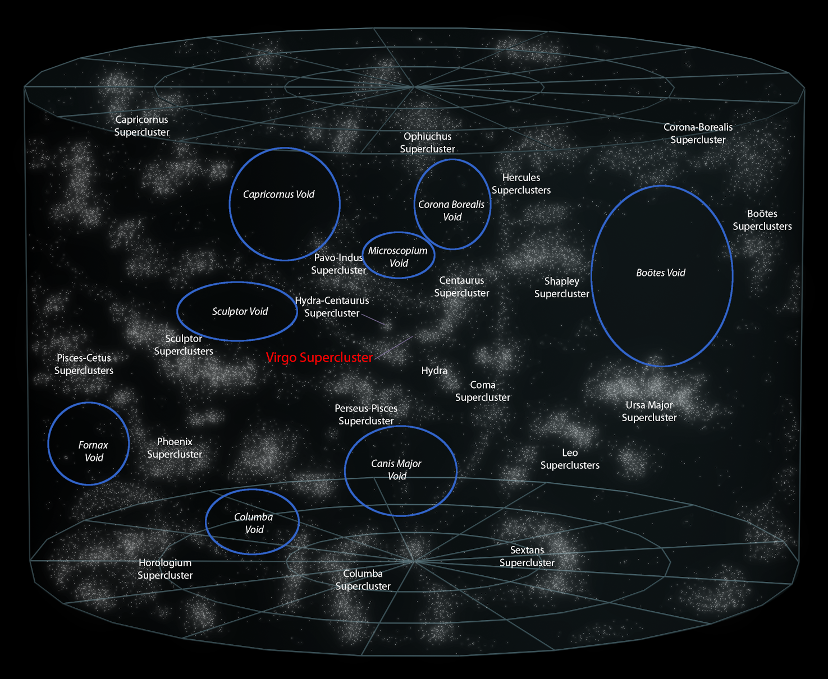
What are Cosmic Voids?
Vast regions of relatively low densities
Image Source: Wikipedia

Slide 5
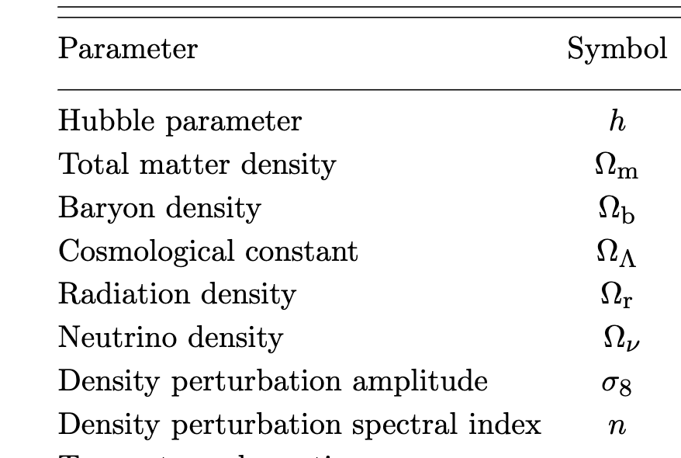
What are Cosmological Parameters?
We only focus on the 5 following parameters: Ω_m, Ω_b, n_s, h, 𝜎_8.
Image Source: Wikipedia

Slide 6
Scientific Question
Given Cosmic Void Properties, can we accurately predict the Cosmological Parameters of the Universe?

Slide 7
Science Motivation and Why Machine Learning?
Theoretical models require robust modelling of void size function, density profile etc.
Theoretical models assume ideal situations which may not be true for actual observations!
Large Simulation Dataset available!
Relationship between void properties like ellipticity and cosmological properties needs more exploration!

Slide 8
Metrics of Success
Recreating the results from the paper!
Comparing Quantitative metrics: R^2 and RMSE!
Implementing end-to-end, fully connected Neural Network models

Slide 9

ETTING 10 GB OF VOID DATA AND PREPARING IT

Slide 10
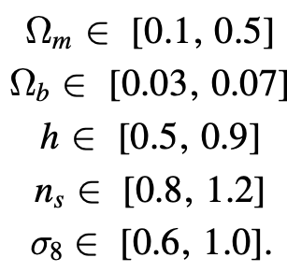
Part 2: Understanding Void Data
Simulation data obtained from Globus
GigantesVoid with ~1 billion voids!
All voids at z = 0.0
2000 catalogs with ~2000 voids each
Used shape and position files
No void cuts and no data conversion
ellipticity = e, radius = r, density contrast = d

Slide 11
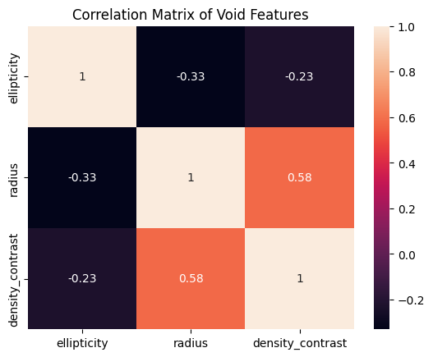
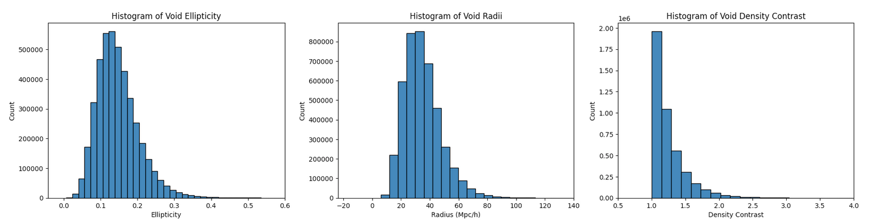
Part 3: Exploring the Data
Used e, r, d
Only 1 catalog had NaN values
No outliers identified
Features had no significant correlation

Slide 12
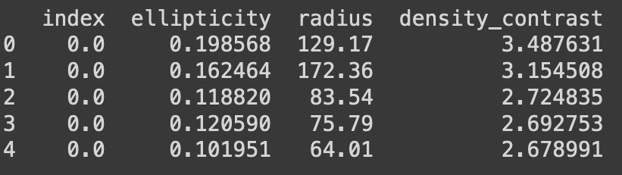
Part 4: Data Cleaning
Data cleaned to have e, r, d only
Dropping NaN catalog removed 1/2000th of data
Same for cosmological parameters
Data was indexed according to catalog
Models use different number of features

Slide 13
HOW TO TRAIN YOUR FULLY CONNECTED NEURAL NETWORK

Slide 14
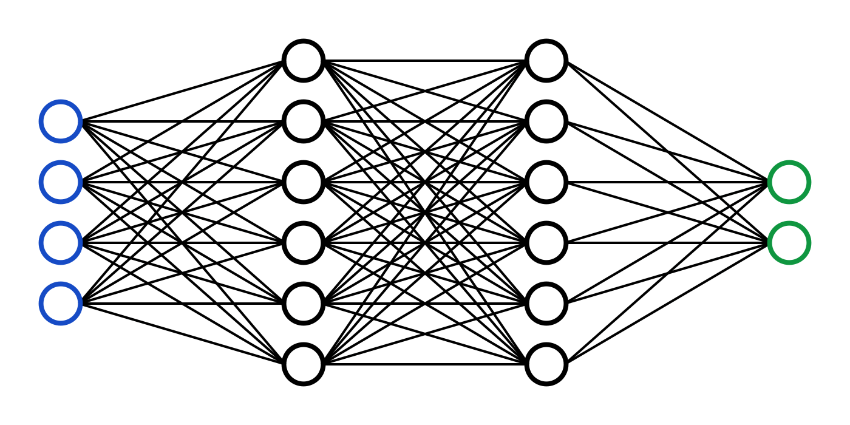
Part 5: Why Neural Networks?
The relationship between the features and targets is very complex and cannot be analyzed using simple models
The data to be analyzed is very large, containing millions of void catalogs to analyze.
Neural networks ignore outliers parameters by dropping the weights of the outlier nodes.
Neural networks offer flexibility in architecture design, they are scalable to accommodate future expansions in data volume and complexity
Notes:
Due to the non-linear complex connections between the features and the targets, models such as random forest and regression models would not compute accurate results for the data.

Slide 15
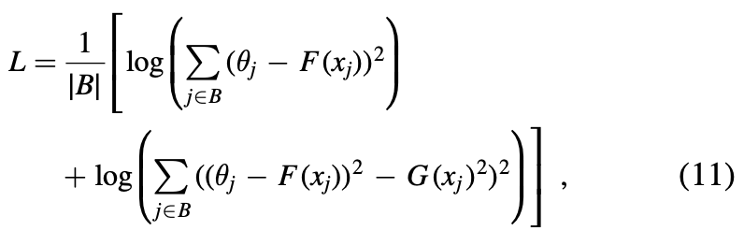
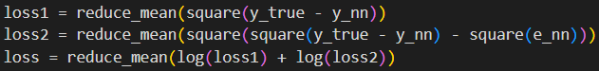
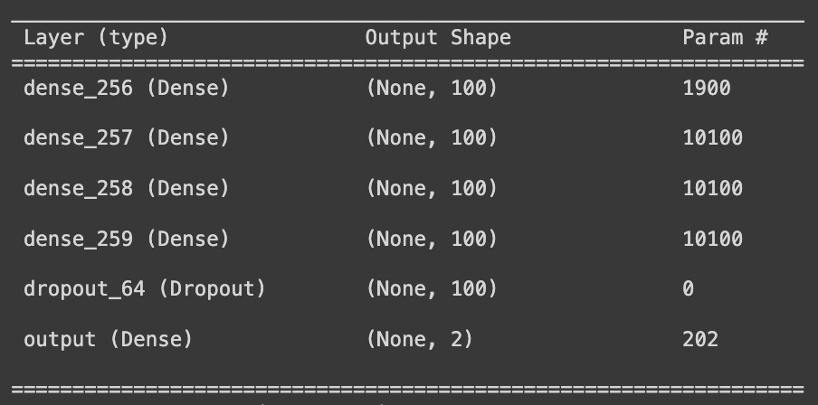
Part 5: Loss Functions and NN model architecture
Loss functions used:
Mean Squared Logarithmic Error.
Custom Loss Functions.
Model Architectures:
1 Input, 3 Inputs -> 1 Output, 10 Outputs
4 dense layers - 100, ReLU
1 dropout layer - 0.2
AdamW optimization
1 or 10 node output layer
Notes:
Slide talking about the neural networks used in the project and the architecture of the models :
1feature->1target
3features->1target
3features->all_targets

Slide 16
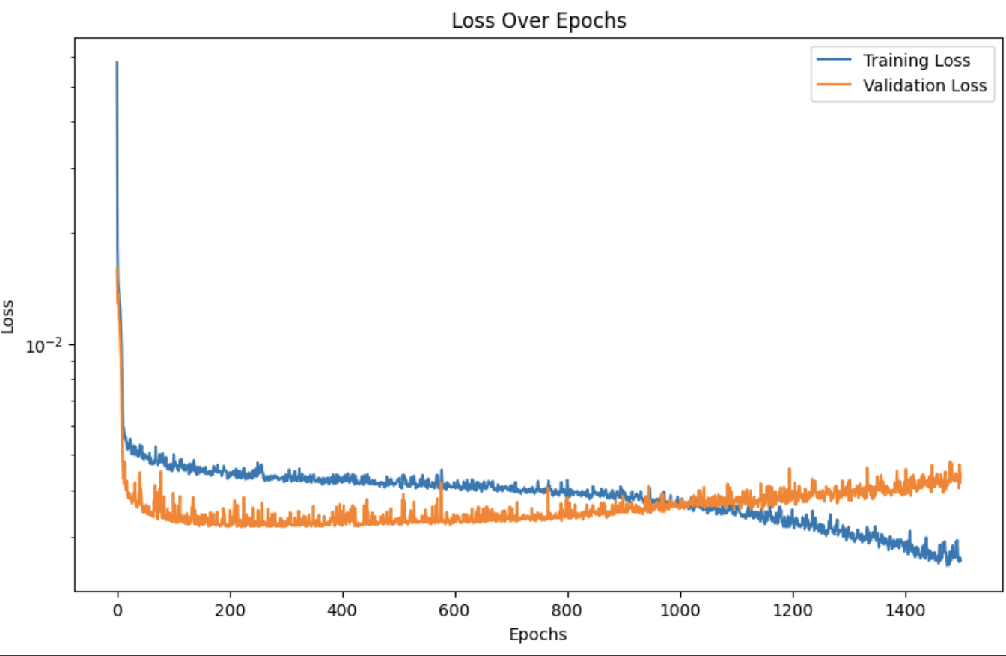
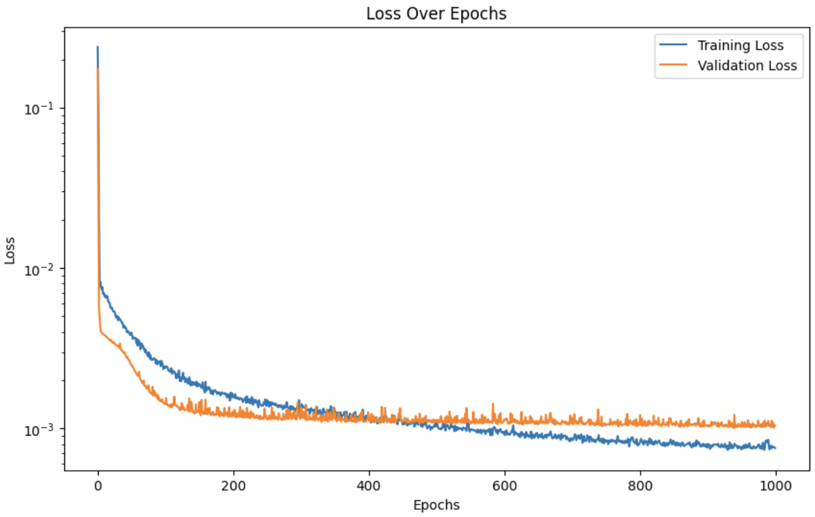
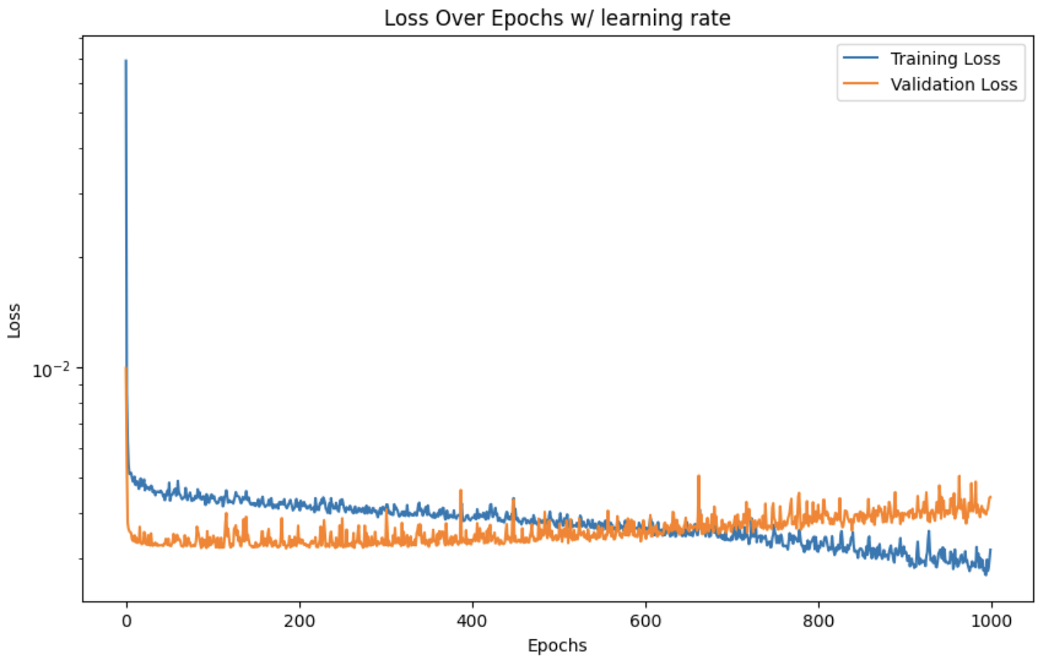
Part 5: Neural Network Models
Model 1:
1 Feature (e) ͢
1 Target(Ω_m)
Model 2:
3 features (e, r, d) ͢
1 Target(Ω_m)
Model 3:
3 features (e, r, d) ͢
All Targets(Ω_m, n_s, h, Ω_b, σ_8)
Notes:
Neural network can be tuned by changing the learning rate, weight decay, epochs, batch size, activation function, Here are some graphs showcasing the loss results for the training and validation data.
SFor this project we have trained various distinct neural networks, with the main difference between them being the number of features and targets they are trained:
THe authors faced similar challenges with the more complex model and their predictions.

Slide 17
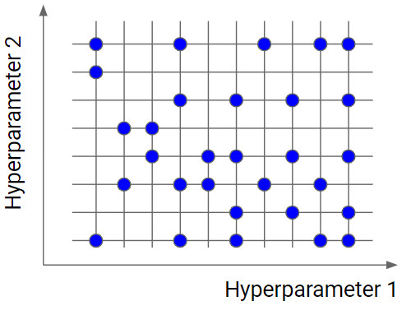

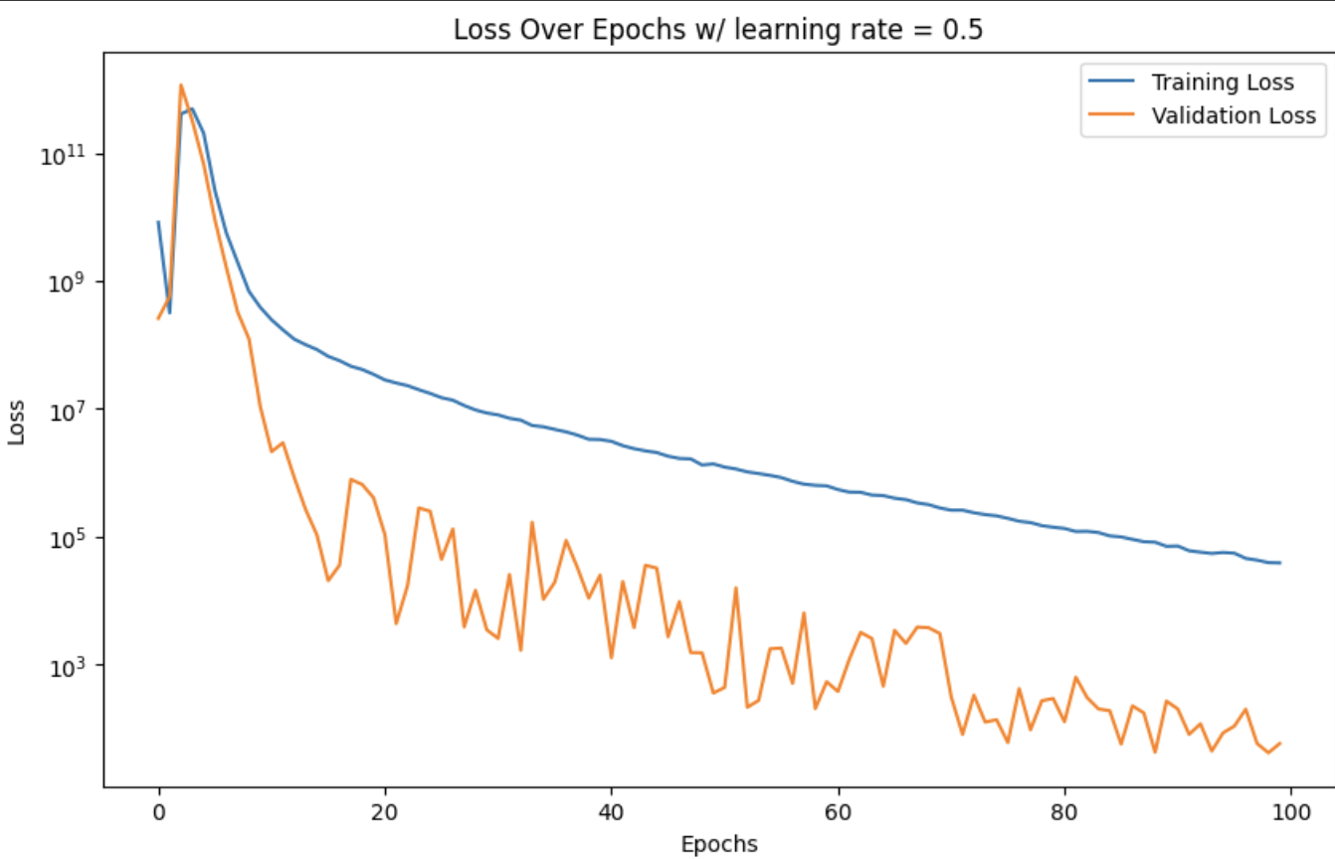
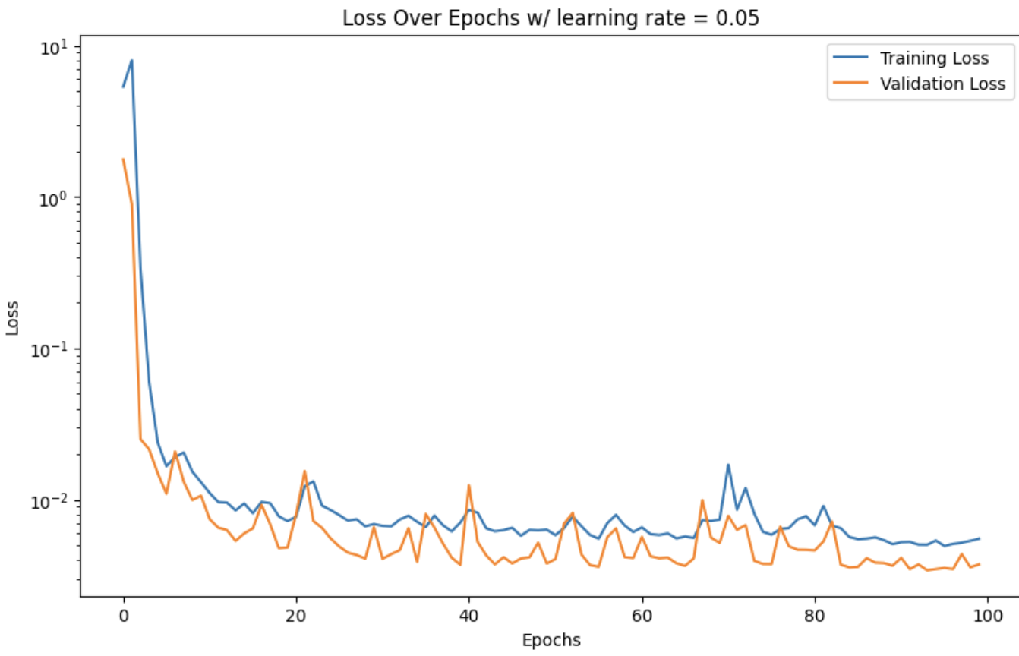
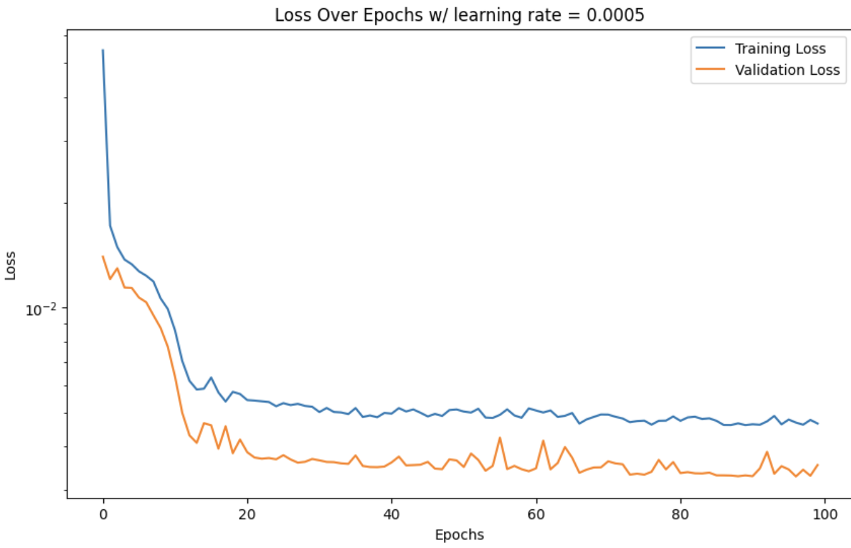
Part 6: Fine Tuning NNs
Hyperparameter Optimization:
Grid Search
Generates models for all possible combinations of given hyperparameters.
Optuna Optimization (Used by authors)
Tree-structured Parzen Estimator (TPE) algorithm.
Notes:
In order to find the best fit hyperparameters for the models, we ran an hyperparameter optimization framework to automate hyperparameter search Tree-structured Parzen Estimator (TPE):
TPE is a Bayesian approach that models the probability distribution of hyperparameters given the scores (e.g., loss or accuracy) they achieved.
It creates two distributions: one for hyperparameters resulting in good scores and one for those leading to poorer scores.
The ratio of these two distributions is used to estimate the expected improvement (EI) of new hyperparameter sets.
Selection of Next Hyperparameters:
Based on the EI, TPE proposes the next set of hyperparameters to evaluate. The idea is to choose hyperparameters that are likely to yield improvements.
This approach contrasts with random or grid search methods, as it leverages past trial results to make informed decisions on which areas of the hyperparameter space to explore next.
Iterative Process:
As more trials are conducted, the TPE model gets updated with the new results, refining its understanding of the objective function.
This process continues iteratively, with Optuna using the updated TPE model to propose increasingly effective hyperparameter configurations.
Efficiency:
Bayesian optimization is particularly beneficial for optimizing complex functions with a limited budget for evaluations, as is often the case in hyperparameter tuning.
It's generally more efficient than grid search or random search, especially in high-dimensional spaces.
Example of varying the learning rate hyperparameter graph

Slide 18
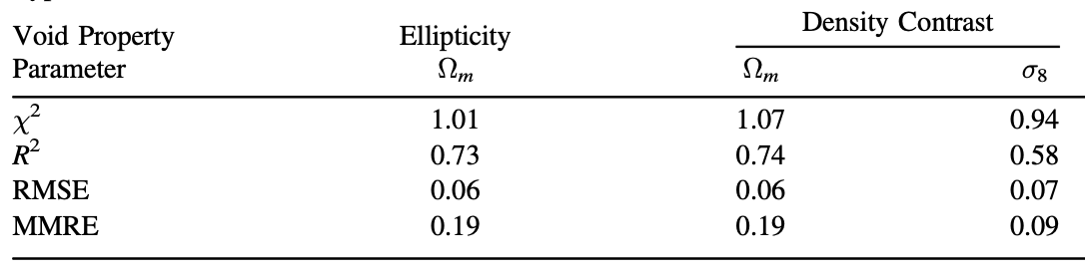
Part 7: Evaluating Model Performance
Void Property | Ellipticity | All Three Void Properties | All Three Void Properties
Parameter | Ω_m | Ω_m | σ_8
MAE | 0.0504 | 0.0444 | 0.0438
R^2 | 0.6852 | 0.7534 | 0.7564
RMSE | 0.0634 | 0.0561 | 0.0576
MSE | 0.0040 | 0.0032 | 0.0033
Notes:
Some of our metrics along side the authors metrics for different models and predictions

Slide 19
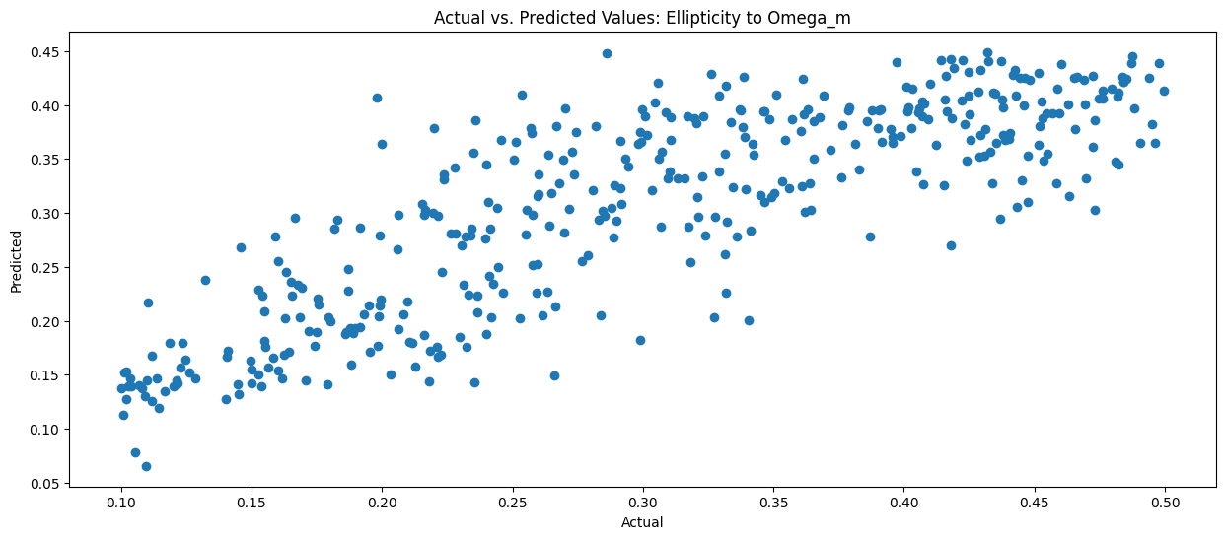
Part 7: Evaluating Model Performance
R^2 = 0.6852
Notes:
Plot something like this for the results section of the presentation
0.04516524712222814
Mean Squared Error (MSE): 0.0031779328213800227
Root Mean Squared Error (RMSE): 0.05637315692224468
R-squared: 0.752562356038855

Slide 20
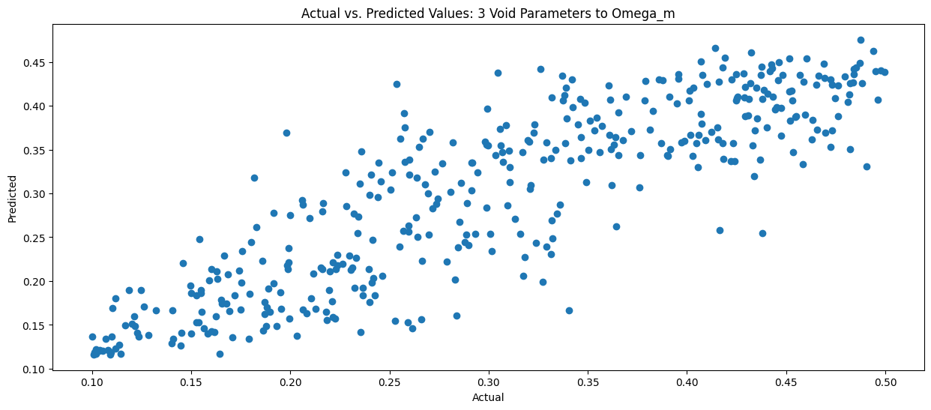
Part 7: Evaluating Model Performance
R^2 = 0.7534
Notes:
Plot something like this for the results section of the presentation
0.04516524712222814
Mean Squared Error (MSE): 0.0031779328213800227
Root Mean Squared Error (RMSE): 0.05637315692224468
R-squared: 0.752562356038855

Slide 21
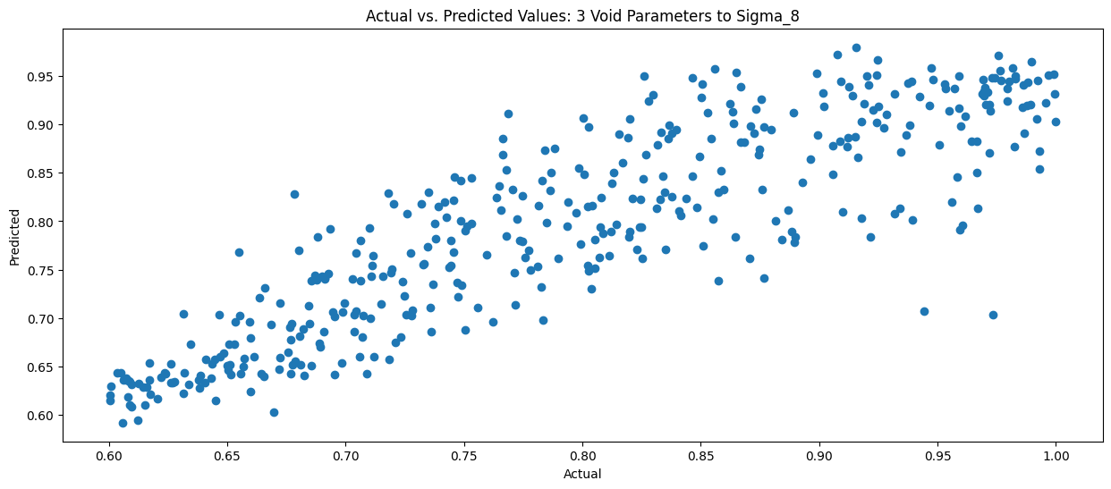
Part 7: Evaluating Model Performance
R^2 = 0.7564
Notes:
Plot something like this for the results section of the presentation
0.04516524712222814
Mean Squared Error (MSE): 0.0031779328213800227
Root Mean Squared Error (RMSE): 0.05637315692224468
R-squared: 0.752562356038855

Slide 22
Part 7: Evaluating Model Performance
Parameter | Ω_m | Ω_b | h | n_s | σ_8
MAE | 0.0454 | 0.0098 | 0.0964 | 0.0820 | 0.0446
R^2 | 0.7582 | -0.0036 | 0.0143 | 0.2889 | 0.7612
RMSE | 0.0556 | 0.0115 | 0.1141 | 0.0985 | 0.0570
MSE | 0.0031 | 0.0001 | 0.0130 | 0.0097 | 0.0032
Notes:
Plot something like this for the results section of the presentation
0.04516524712222814
Mean Squared Error (MSE): 0.0031779328213800227
Root Mean Squared Error (RMSE): 0.05637315692224468
R-squared: 0.752562356038855

Slide 23
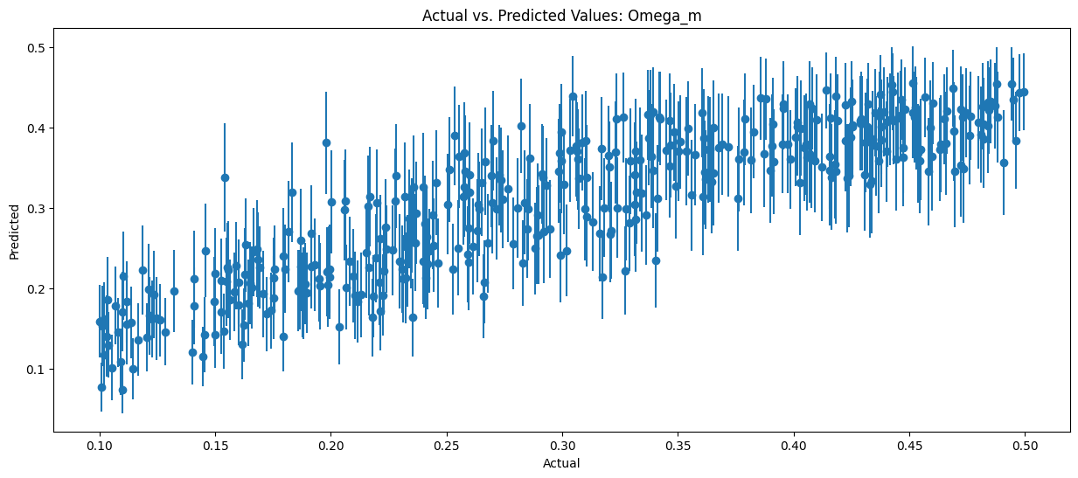
Part 7: Evaluating Model Performance
R^2 = 0.7582
Notes:
Plot something like this for the results section of the presentation
0.04516524712222814
Mean Squared Error (MSE): 0.0031779328213800227
Root Mean Squared Error (RMSE): 0.05637315692224468
R-squared: 0.752562356038855

Slide 24
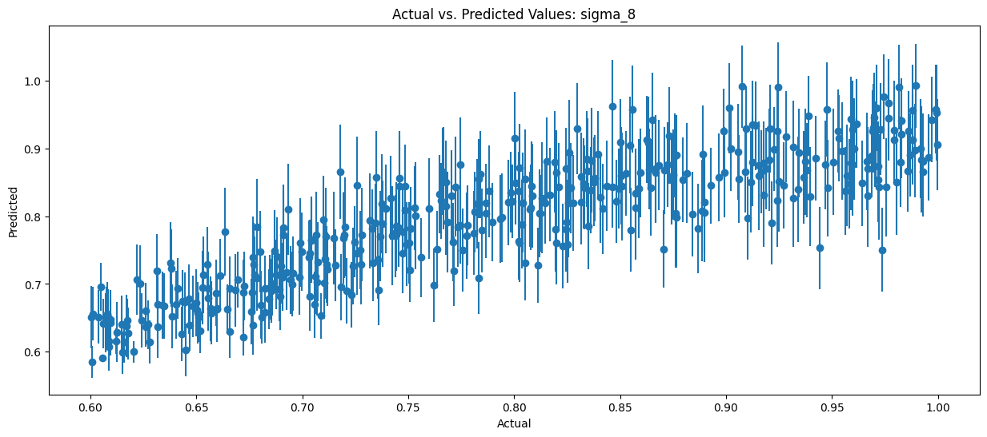
Part 7: Evaluating Model Performance
R^2 = 0.7612
Notes:
Plot something like this for the results section of the presentation
0.04516524712222814
Mean Squared Error (MSE): 0.0031779328213800227
Root Mean Squared Error (RMSE): 0.05637315692224468
R-squared: 0.752562356038855

Slide 25
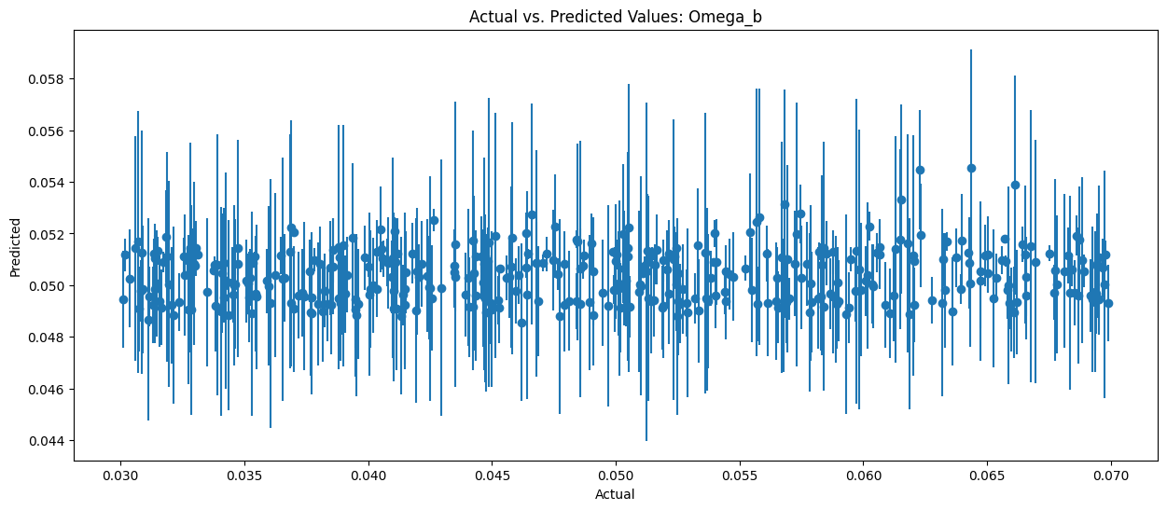
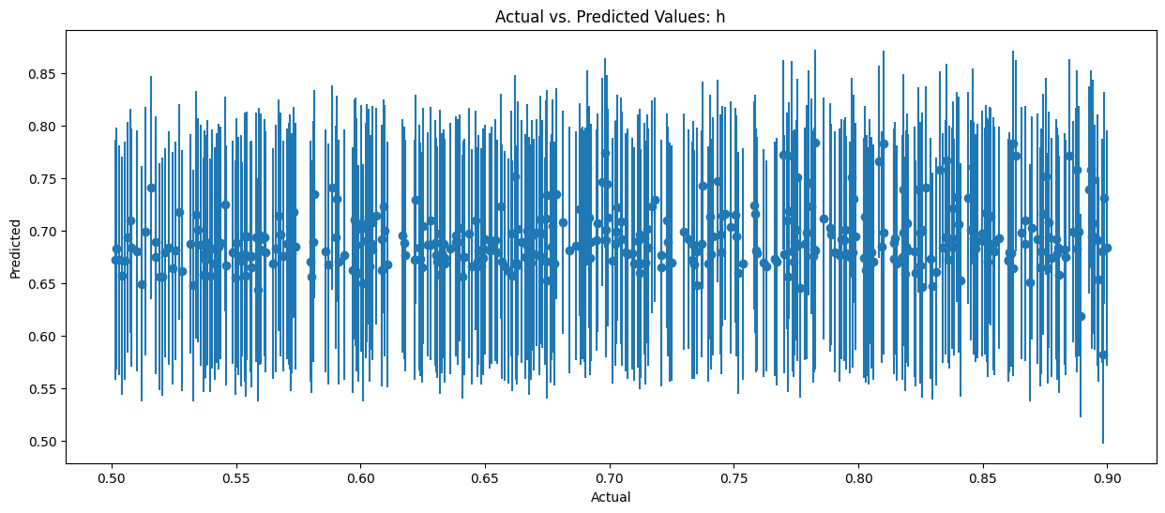
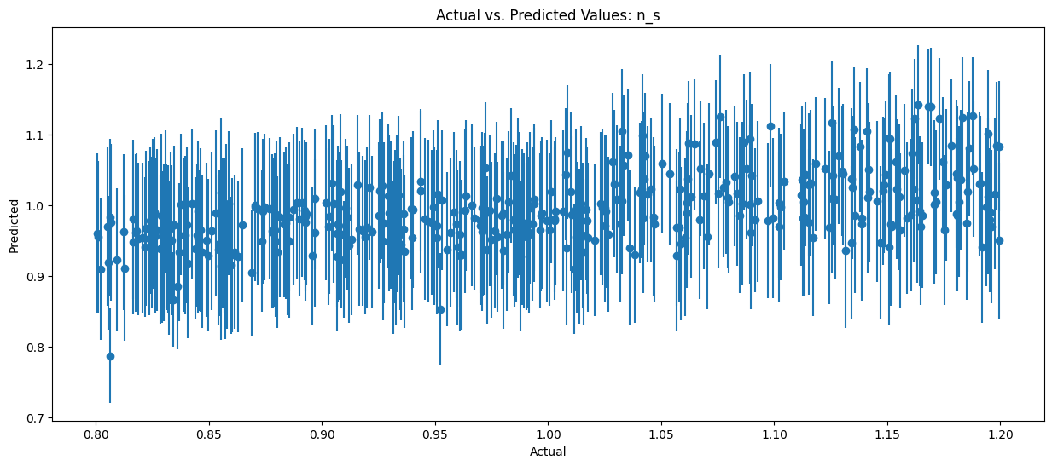
Part 7: Evaluating Model Performance
R^2 = -0.0036
R^2 = 0.0143
R^2 = 0.2889
Notes:
Plot something like this for the results section of the presentation
0.04516524712222814
Mean Squared Error (MSE): 0.0031779328213800227
Root Mean Squared Error (RMSE): 0.05637315692224468
R-squared: 0.752562356038855

Slide 26
Conclusions
Implemented and end-to-end Neural Network model in Tensorflow!
Deep Sets and more complicated architectures
Our results are within reasonable error bounds as compared to the paper
Hypertuning improved model performance according to R^2 metrics
Able to create mapping from void parameters to cosmological parameters Ω_m and σ_8!

Slide 27
References
https://www.scientificamerican.com/article/how-analyzing-cosmic-nothing-might-explain-everything/
https://astronomynow.com/2016/08/12/astronomers-use-cosmic-voids-to-study-the-universe/
https://www.space.com/why-avoid-the-cosmic-voids.html
https://www.worldscientific.com/doi/pdf/10.1142/S2010194511000092

Slide 28
QUESTIONS?

